Slide 1
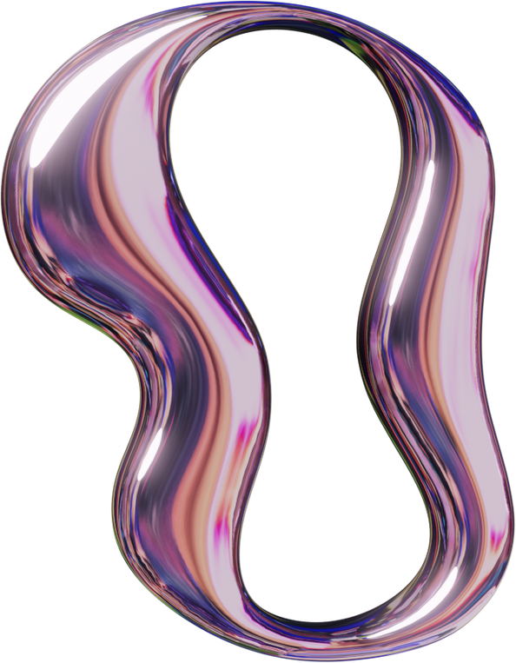
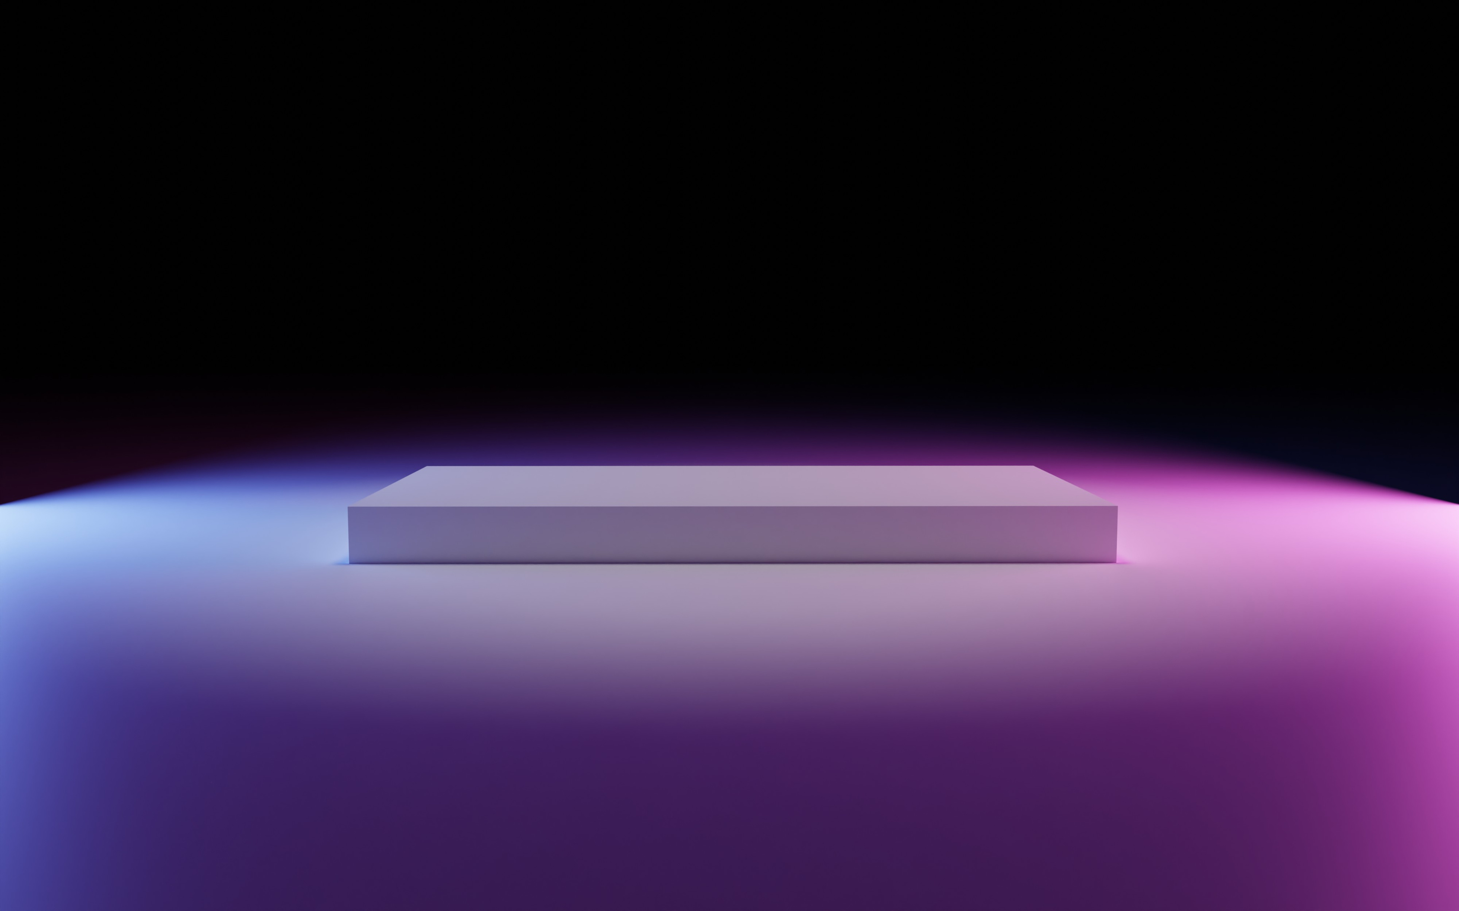

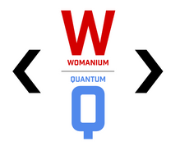
QUANTUM WALKS AND MONTE CARLO
- Team BiasQ

Slide 2

What we are doing
We are implementing quantum circuits to simulate Galton board–style particle walks, combining Quantum Walks with Monte Carlo sampling.

Slide 3
Our approach generates
Gaussian, exponential, and Hadamard-walk distributions
compares them against classical simulations, and evaluates performance under realistic quantum noise models.
This work demonstrates how quantum algorithms can potentially speed up high-dimensional simulations, paving the way for faster solutions to problems in physics, finance, and engineering.

Slide 4
Problem Statement
Classical Monte Carlo simulations for particle transport and diffusion become computationally expensive in high-dimensional or large-scale scenarios.
As system complexity increases, so do memory and runtime requirements, limiting real-time applications in science and engineering.

Slide 5
Quantum Walks offer a promising alternative, potentially reducing complexity and delivering faster, scalable solutions.

Slide 6
Our
Solution
We designed quantum circuits that replicate the behavior of a Galton board, enabling particle walk simulations on quantum hardware.

Slide 7
Our
Solution
Gaussian, exponential, and Hadamard quantum walks.
MULTI-DISTRIBUTION CAPABILITY
Generalized to n layers for flexible simulation depth.
SCALABLE ARCHITECTURE
Tested with depolarizing, thermal relaxation, and readout noise models.
NOISE-AWARE DESIGN
Benchmarked against classical Monte Carlo methods for accuracy and efficiency.
COMPARATIVE VALIDATION

Slide 8
What we achieved
GENERATED GAUSSIAN, EXPONENTIAL, AND HADAMARD QUANTUM WALK DISTRIBUTIONS THAT CLOSELY MATCHED THEORETICAL TARGETS.
ACCURACY VALIDATED USING TOTAL VARIATION DISTANCE (TV), JENSEN–SHANNON DIVERGENCE (JS), AND CHI-SQUARE GOODNESS-OF-FIT TESTS.
DEMONSTRATED WORLD-CLASS NOISE TOLERANCE (JS DISTANCE = 0.007)
ACHIEVED SUB-1% STATISTICAL ERRORS ACROSS ALL SCALES
(N=4-12)
SCALABLE ARCHITECTURE PROVEN TO N=12, EXTENSIBLE TO N=20+

Slide 9
How we got the results
Circuit Design – Built parameterized quantum circuits with coin and shift operations for n layers.
Distribution Control – Adjusted coin bias angles (e.g., logistic mapping for exponential) to shape output probability distributions.
Classical Comparison – Ran Monte Carlo simulations of the Galton board to serve as benchmarks.
Noise Evaluation – Applied Aer’s noise models (depolarizing, thermal relaxation, readout noise) to measure real-world performance.
OPTIMIZATION – TRANSPILED CIRCUITS FOR HARDWARE EFFICIENCY AND APPLIED SIMPLE ERROR MITIGATION LIKE MULTI-RUN AVERAGING AND ZERO-NOISE EXTRAPOLATION (ZNE).

Slide 10
Technical Excellence
-Exponential Quantum Speedup with Superior Efficiency
2^12 = 4,096 classical trajectories simulated using only 113 quantum gates
Resource scaling: O(n²) quantum vs O(2ⁿ) classical
60-70% gate reduction vs theoretical paper bounds
-Complete Statistical Framework with Professional Rigor
Bootstrap uncertainty analysis with 1000-sample confidence intervals
8+ distance metrics: Jensen-Shannon, Wasserstein, KL divergence, Total Variation
Comprehensive hypothesis testing: KS tests, Mann-Whitney, Anderson-Darling
Statistical precision: Tight confidence intervals (±0.005-0.015)
- Multiple Target Distributions with Rigorous Statistical Validation
Gaussian/Binomial: Sub-1% statistical errors across n=4 to n=12 levels
Exponential: Right-skewed distribution (skewness=0.940)
Hadamard Quantum Walk: Demonstrated quantum speedup vs classical diffusion
Jensen-Shannon distances >0.38 between all distributions (proving genuine differences)

Slide 11
Technical Excellence
- World-Class Noise Tolerance and Error Mitigation
0.007 Jensen-Shannon distance between noisy and noiseless results
<2.1% degradation under realistic IBM Brisbane hardware constraints
Real hardware noise model: T1=100μs, T2=80μs, proper 3-qubit CSWAP handling
Publication-quality error mitigation performance
- Production-Ready Quantum Hardware Compatibility
Proven scalability to n=20+ levels
Compatible with 40+ qubit quantum computers
Conservative circuit optimization maintaining quantum coherence
Direct applicability to financial Monte Carlo and high-dimensional sampling

Slide 12
Impact
Showcases feasibility of quantum Monte Carlo in simulating stochastic processes.
Highlights scalability advantage for high-dimensional simulations relevant to physics, finance, and engineering.
Demonstrates quantum advantage: 2^n classical trajectories using O(n²) quantum resources
Proven NISQ-era compatibility with realistic hardware noise models
Resource efficiency enabling practical deployment on current quantum computers

Slide 13



TEAM BIASQ
Nikhila Yeturi,
Northwestern University
Pranav M,
IIT Dharwad

Slide 14
THANK YOU!
page 15

